Slide 1
Fundamentals of Database Concepts
Lecture 2: Modeling Data in the Organization
Prof. Dr. Taysir Hassan Abdel Hamid
IS Department,
Faculty of Computers and Information
Assiut University
April 10, 2021

Slide 2
Agenda
Data Models, Schemas, and Instances
The Entity Relationship Diagram (ERD)
Database Languages

Slide 3
1. Data Models, Schemas, and Instances
A data model – a collection of concepts that can be used to describe the structure of a database.
Data Model Operations: Operations for specifying database retrievals and updates by referring to the concepts of the data model. Operations on the data model may include basic operations and user-defined operations.

Slide 4
Categories of data models
Conceptual (high-level, semantic) data models: Provide concepts that are close to the way many users perceive data. (Also called entity-based or object-based data models.)
Physical (low-level, internal) data models: Provide concepts that describe details of how data is stored in the computer.
Implementation (representational) data models: Provide concepts that fall between the above two, balancing user views with some computer storage details.

Slide 5
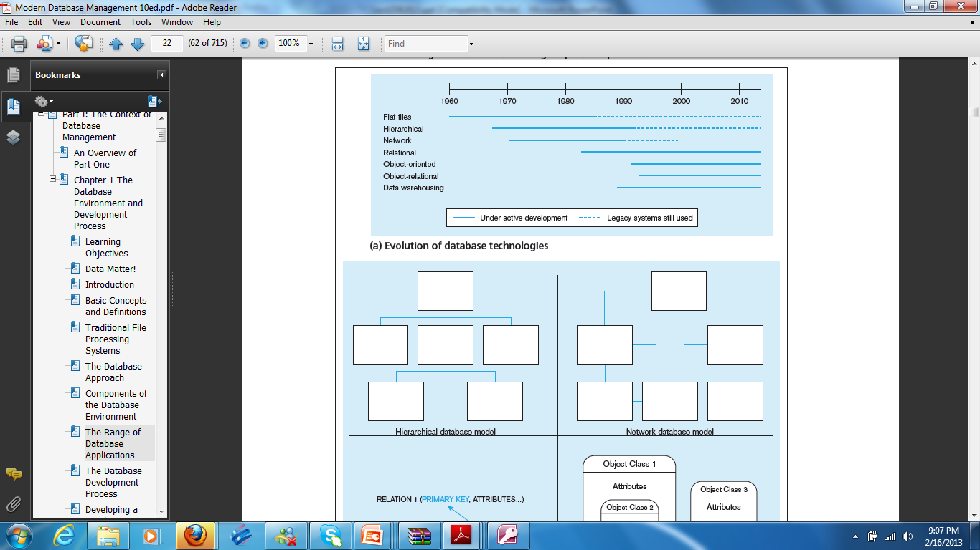

Slide 6
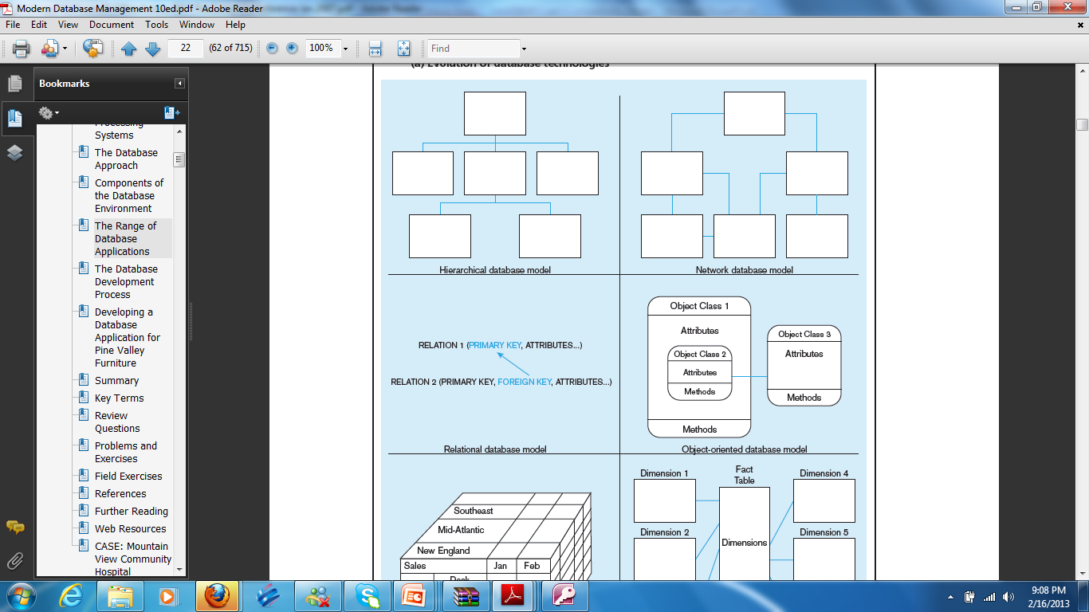

Slide 8
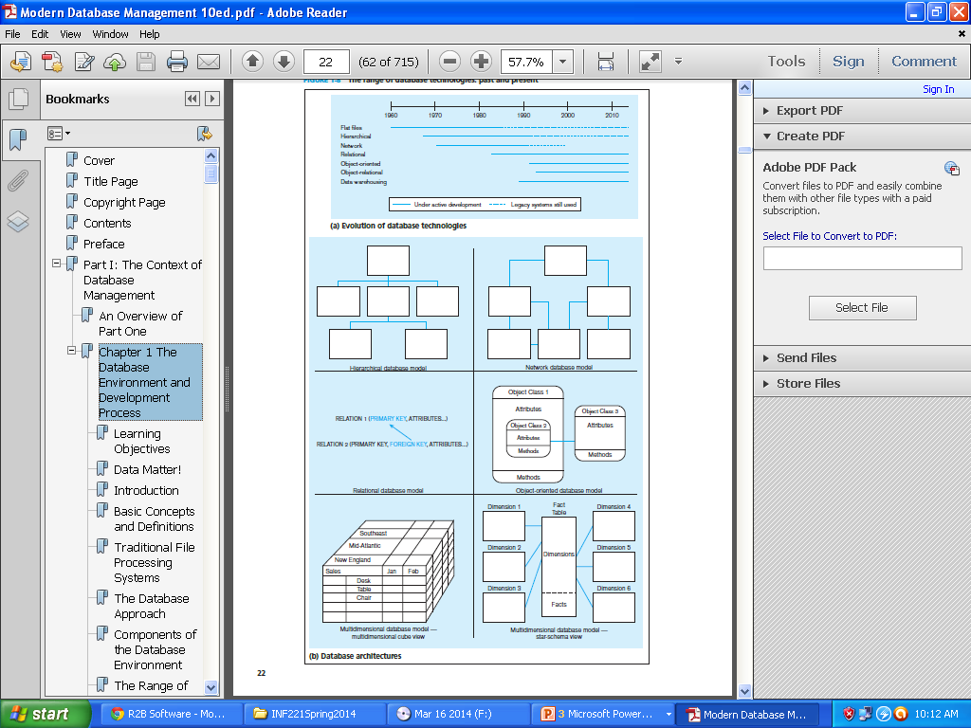

Slide 9
History of Data Models
Network Model: the first one to be implemented by Honeywell in 1964-65 (IDS System). Adopted heavily due to the support by CODASYL (CODASYL - DBTG report of 1971). Later implemented in a large variety of systems - IDMS (Cullinet - now CA), DMS 1100 (Unisys), IMAGE (H.P.), VAX -DBMS (Digital Equipment Corp.).
Hierarchical Data Model: implemented in a joint effort by IBM and North American Rockwell around 1965. Resulted in the IMS family of systems. The most popular model. Examples are cache,
Relational Model: proposed in 1970 by E.F. Codd (IBM), first commercial system in 1981-82. Now in several commercial products (DB2, ORACLE, SQL Server, SYBASE, INFORMIX).

Slide 10
Hierarchical Model
Well suited for data which are in some way related
Hierarchically begin with a strictly defined tree of data nodes
Each node can contain some identifying data, plus a set of subnodes of a specific child type

Slide 11
History of Data Models (Cont…)
Object-oriented Data Model(s): several models have been proposed for implementing in a database system. One set comprises models of persistent O-O Programming Languages such as C++ (e.g., in OBJECTSTORE or VERSANT), and Smalltalk (e.g., in GEMSTONE). Additionally, systems like O_{2,} ORION (at MCC - then ITASCA), IRIS (at H.P.- used in Open OODB).
Object-Relational Models: Most Recent Trend. Started with Informix Universal Server. Exemplified in the latest versions of Oracle-10i, Oracle 11, DB2, and SQL Server etc. systems.

Slide 12
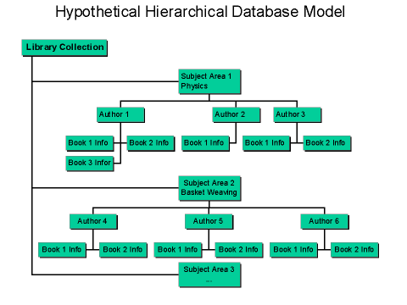
Hierarchical Model (Cont…)

Slide 13
Hierarchical Model
ADVANTAGES:
  Hierarchical Model is simple to construct and operate on
  Corresponds to a number of natural hierarchically organized domains - e.g., assemblies in manufacturing, personnel organization in companies
  Language is simple; uses constructs like GET, GET UNIQUE, GET NEXT, GET NEXT WITHIN PARENT etc.
DISADVANTAGES:
  Navigational and procedural nature of processing
  Database is visualized as a linear arrangement of records
  Little scope for "query optimization"

Slide 14
Network Model
Supported more complex relations
Physical file pointers were used to model the relations between files
Relations had to be decide in advance
Most suitable for large databases with well defined queries and well-defined applications.

Slide 15
Network Model (Contd.)
Authors
Subjects
Books
Publishers

Slide 16
Network Model (Cont…)
In other words, according to the network data model the information within a database is arranged as a collection of record occurrences and a collection of set occurrences.

Slide 17
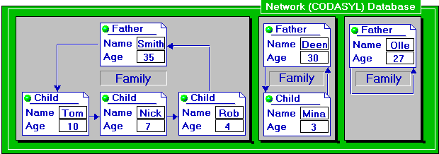
Example of Network Data Model:

Slide 18
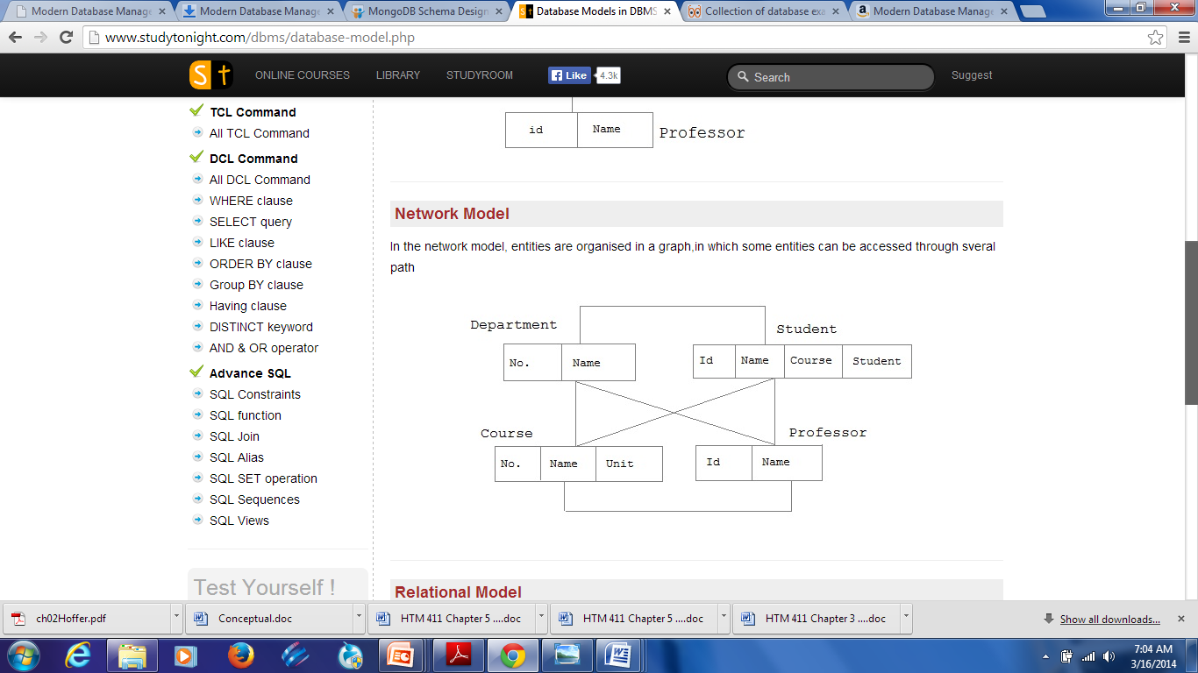

Slide 19
Network Model
ADVANTAGES:
  Network Model is able to model complex relationships and represents semantics of add/delete on the relationships.
  Can handle most situations for modeling using record types and relationship types.
  Language is navigational; uses constructs like FIND, FIND member, FIND owner, FIND NEXT within set, GET etc. Programmers can do optimal navigation through the database.
DISADVANTAGES:
  Navigational and procedural nature of processing
  Database contains a complex array of pointers that thread through a set of records.
  Little scope for automated "query optimization”

Slide 20
Relational Model (1970’s)
E.F. Codd introduced the relational model in 1970
Provides a conceptually simple model for data as relations (typically considered “tables”) with all data visible.
DB2 from IBM is the first DBMS product based on the relational model

Slide 21
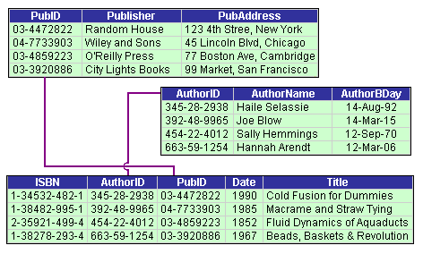
Relational Model (Contd.)

Slide 22
Relational Model (Cont...)
Other DBMS based on the relational model were developed in the late 1980s
Today, DB2, Oracle, and SQL Server are the most prominent commercial DBMS products based on the relational model

Slide 23
Object Oriented Data Model (1990’s)
Goal of OODBMS is to store object-oriented programming objects in a database without having to transform them into relational format.
Extend the entity-relationship data model by including encapsulation, methods and object identity

Slide 24
Object-relational models
Extend the relational data model by including object orientation and constructs to deal with added data types.
Allow attributes of tuples to have complex types, including non-atomic values such as nested relations.
Preserve relational foundations, in particular the declarative access to data, while extending modeling power.

Slide 25
CMDB
The CMDB records Configuration Items (CI) and details about the important attributes and relationships between CIs. Configuration managers usually describe CIs using three configurable attributes:
  Technical
  Ownership
  Relationship
CMDBs are used to keep track of the state of different things that are normally referred to as assets, such as products, systems, software, facilities, and people as they exist at specific points in time.
The maintenance of such state related information allows for things like the reconstruction of such assets, at any point in their existence, as well as for things such as impact analysis, in the cases of root cause analysis or change management.

Slide 26
CMDB (Cont…)
A key success factor in implementing a CMDB is the ability to automatically discover information about the CIs (auto-discovery) and track changes as they happen.
CMDBs contain metadata, and thus the concept overlaps with that of a metadata repository which are both used in running large IT organizations. Configuration management addresses how the data is to be kept up to date, which has historically been a weakness of metadata repositories.

Slide 27
Schemas versus Instances
Database Schema: The description of a database. Includes descriptions of the database structure and the constraints that should hold on the database.
Schema Diagram: A diagrammatic display of (some aspects of) a database schema.
Schema Construct: A component of the schema or an object within the schema, e.g., STUDENT, COURSE.
Database Instance: The actual data stored in a database at a particular moment in time. Also called database state (or occurrence).

Slide 28
Database Schema Vs. Database State
Database State: Refers to the content of a database at a moment in time.
Initial Database State: Refers to the database when it is loaded
Valid State: A state that satisfies the structure and constraints of the database.
Distinction
  The database schema changes very infrequently. The database state changes every time the database is updated.
  Schema is also called intension, whereas state is called extension.

Slide 29
Now…
Consider the following example

Slide 30
An Example Database Application
The company database keeps track of a company’s employees, departments, and projects.
The company is organized into departments: Each department has a unique number, a unique name, and an employee who manages the department.
A department controls a number of projects, each of which has a unique names, a unique number, and a single location.
We store each employee’s name, social security number, address, salary, gender and birth date.
Keep track of dependents of each employee for insurance purposes.

Slide 31
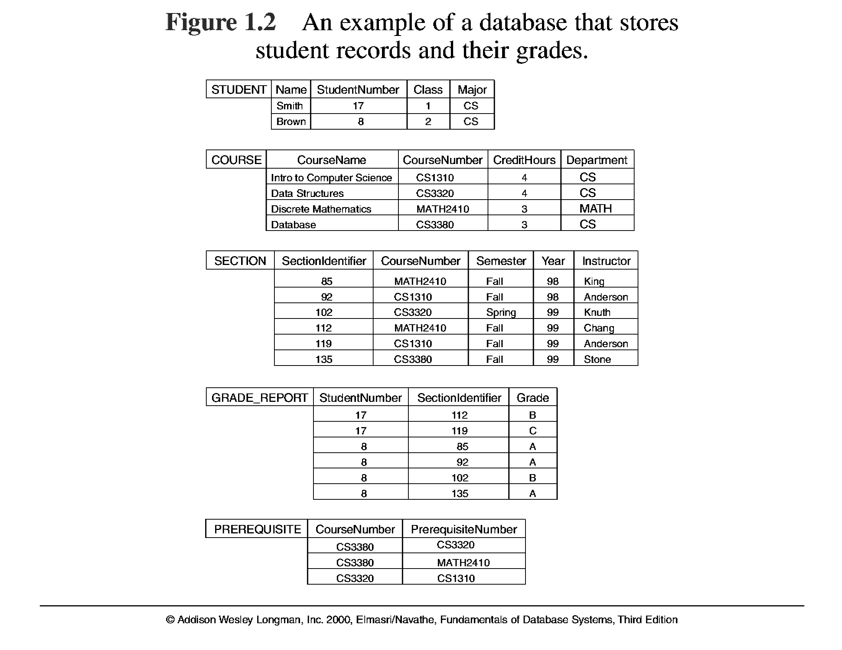

Slide 32
Schema Diagram
Student
Name | Studentnumber | Class | Major
Course
CourseName | CourseNumber | Department

Slide 33
Data Independence
Logical data independence – capacity to change the conceptual schema without having to change external schemas or application programs.
Maybe changed to expand the database.
For example, change constraints, records, etc.
Physical data independence – capacity to change the internal schema without having to change the conceptual schema.

Slide 34
3. Database Languages and Interfaces
Once design of a database is completed and a DBMS is chosen to implement the database, what is needed:
To specify conceptual and internal schemas for the database and any mappings between the two – Data Definition Language (DDL).
If clear separation is maintained – Storage Definition Language (SDL) is used to specify the internal schema.
For a true three-schema architecture – the View Definition Language (VDL) is needed to specify user views.

Slide 35
Database Languages and Interfaces (Cont.)
A Data Manipulation Language is needed now (DML): retrieval, insertion, deletion, and modification of the data:
A High-level or non-procedural DML – complex database operations.
A Low-level or procedural DML – must be embedded in a general-purpose programming language.

Slide 36
Entity Types, Entity Sets, Attributes, and Keys
An Entity is the basic object that the ER model represents.
An Entity may be an object with a physical existence, i.e. a person, car, house
Examples: Employee, Department, Project

Slide 37
E-R MODEL CONSTRUCTS
Entity instance–person, place, object, event, concept (often corresponds to a row in a table)
Entity Type–collection of entity instance (often corresponds to a table)
Relationship instance–link between entity instance (corresponds to individual primary key-foreign key value match)
Relationship link between entity types (primary key-foreign key link)
Notes:
2

Slide 38
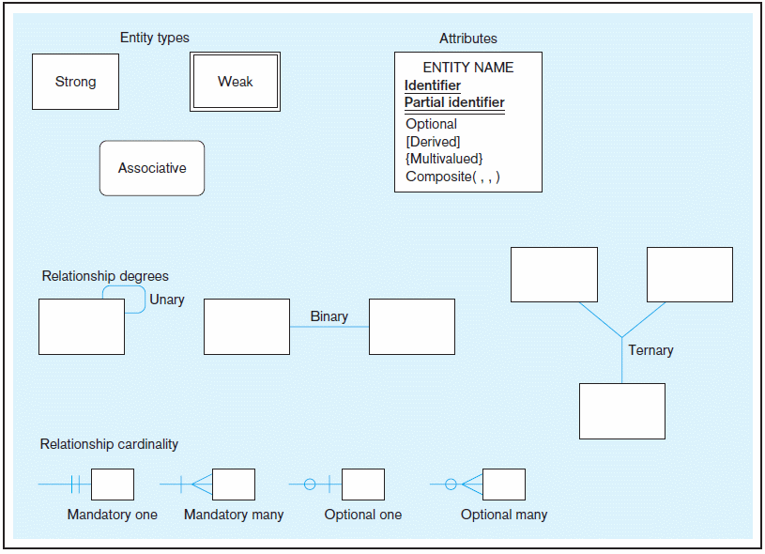
Basic E-R notation (Figure 2-2)
Entity symbols
Attribute symbols
A special entity that is also a relationship
Relationship symbols
Relationship degrees specify number of entity types involved
Relationship cardinalities specify how many of each entity type is allowed
Chapter 2
Notes:
8

Slide 39
Attributes
Attribute–property or characteristic of an entity or relationship type
Classifications of attributes:
  Simple versus Composite Attribute
  Single-Valued versus Multivalued Attribute
  Stored versus Derived Attributes
  Identifier Attributes
Notes:
5

Slide 40
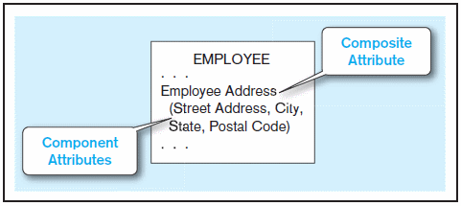
Simple vs. Composite Attributes
Composite attribute – An attribute that has meaningful component parts (attributes)
The address is broken into component parts
Figure 2-7 A composite attribute
Notes:
6

Slide 41
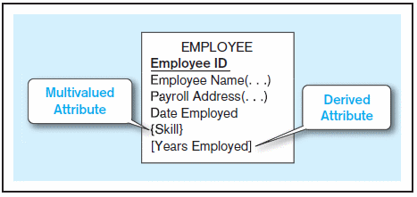
Multi-valued and Derived Attributes
Multivalued – may take on more than one value for a given entity (or relationship) instance
Derived – values can be calculated from related attribute values
Figure 2-8 Entity with multivalued attribute (Skill) and derived attribute (Years Employed)
Derived
Calculated from date employed and current date
Multivalued
an employee can have more than one skill
Chapter 2
Notes:
12

Slide 42
Identifiers (Keys)
Identifier (Key)–an attribute (or combination of attributes) that uniquely identifies individual instances of an entity type
Simple versus Composite Identifier
Notes:
6

Slide 43
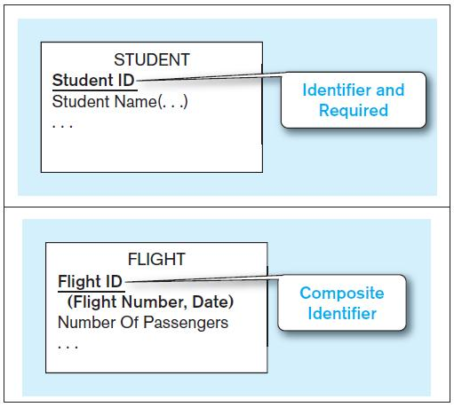


Figure 2-9 Simple and composite identifier attributes
The identifier is boldfaced and underlined
Chapter 2
Notes:
14

Slide 44
Strong vs. Weak Entities, and
Identifying Relationships
Strong entity
  exists independently of other types of entities
  has its own unique identifier
    identifier underlined with single line
Weak entity
  dependent on a strong entity (identifying owner)…cannot exist on its own
  does not have a unique identifier (only a partial identifier)
    entity box and partial identifier have double lines
Identifying relationship
  links strong entities to weak entities

Slide 45
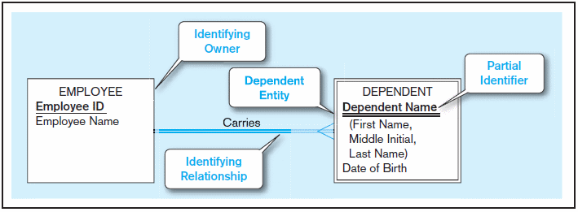
Figure 2-5 Example of a weak identity and its identifying relationship
Strong entity
Weak entity

Slide 46
Modeling Relationships
Relationship Types vs. Relationship Instances
  The relationship type is modeled as lines between entity types…the instance is between specific entity instances
Two entities can have more than one type of relationship between them (multiple relationships)

Slide 47
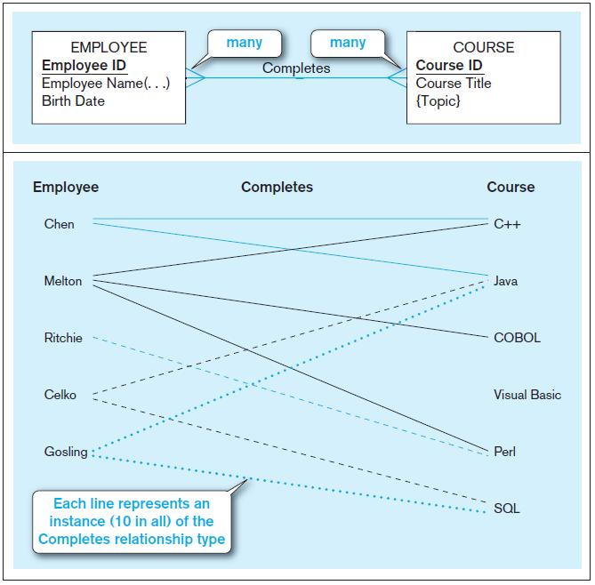
Figure 2-10 Relationship types and instances
a) Relationship type (Completes)
b) Relationship instances
Chapter 2
Notes:
17

Slide 48
Degree of Relationships
Degree of a relationship is the number of entity types that participate in it
  Unary Relationship
  Binary Relationship
  Ternary Relationship
Notes:
16

Slide 49
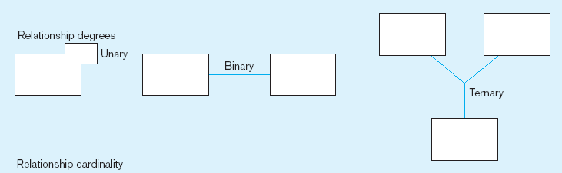
Degree of relationships – from Figure 2-2
Entities of two different types related to each other
One entity related to another of the same entity type
Entities of three different types related to each other
Chapter 2
Notes:
8

Slide 50
Cardinality of Relationships
One-to-One: Each entity instance in the relationship will have exactly one related entity instance
One-to-Many: An entity instance on one side of the relationship can have many related entity instances, but an entity instance on the other side will have a maximum of one related entity instance.
Many-to-Many: An entity instance on either side of the relationship can have many related entity instances on the other side

Slide 51
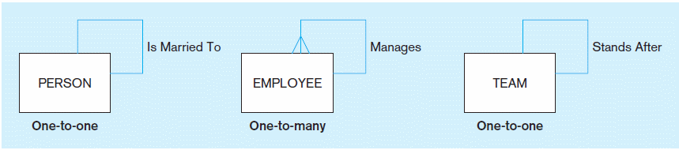
Figure 2-12 Examples of relationships of different degrees
a) Unary relationships
Chapter 2
© 2013 Pearson Education, Inc. Publishing as Prentice Hall
Notes:
22

Slide 52
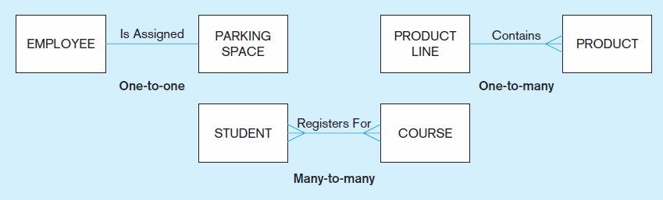
Figure 2-12 Examples of relationships of different degrees (cont.)
b) Binary relationships
Chapter 2
© 2013 Pearson Education, Inc. Publishing as Prentice Hall
Notes:
22

Slide 53
Cardinality Constraints
Cardinality Constraints—the number of instances of one entity that can or must be associated with each instance of another entity
Minimum Cardinality
  If zero, then optional
  If one or more, then mandatory
Maximum Cardinality
  The maximum number
Notes:
29

Slide 54
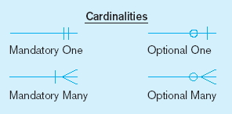
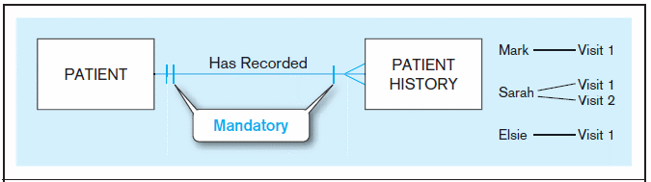
Figure 2-17 Examples of cardinality constraints
a) Mandatory cardinalities
A patient must have recorded at least one history, and can have many
A patient history is recorded for one and only one patient
Notes:
1

Slide 55
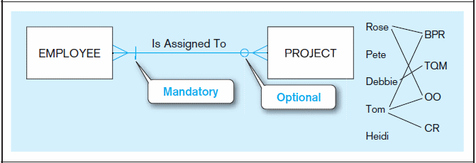
Figure 2-17 Examples of cardinality constraints (cont.)
b) One optional, one mandatory
A project must be assigned to at least one employee, and may be assigned to many
An employee can be assigned to any number of projects, or may not be assigned to any at all
Chapter 2
Notes:
1

Slide 56
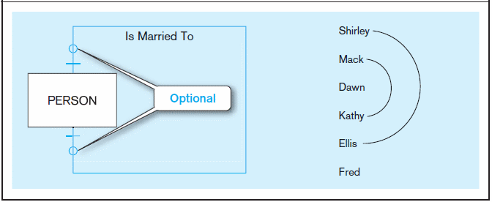
Figure 2-17 Examples of cardinality constraints (cont.)
c) Optional cardinalities
A person is married to at most one other person, or may not be married at all
Chapter 2
Notes:
1

Slide 57
Associative Entities
An entity–has attributes
A relationship–links entities together

Slide 58
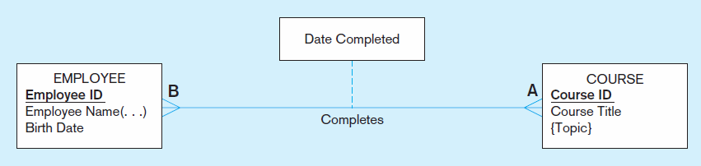
Figure 2-11a A binary relationship with an attribute
Here, the date completed attribute pertains specifically to the employee’s completion of a course…it is an attribute of the relationship.
Chapter 2
Notes:
20

Slide 59
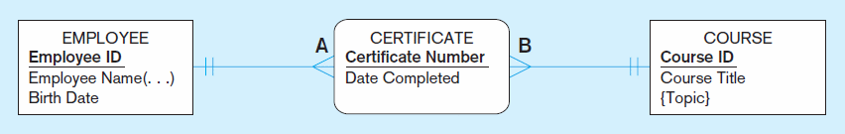
Figure 2-11b An associative entity (CERTIFICATE)
Associative entity is like a relationship with an attribute, but it is also considered to be an entity in its own right.
Note that the many-to-many cardinality between entities in Figure 2-11a has been replaced by two one-to-many relationships with the associative entity.
Chapter 2
Notes:
21

Slide 60
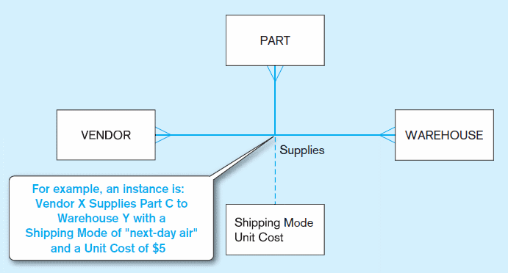
Figure 2-12 Examples of relationships of different degrees (cont.)
c) Ternary relationship
Note: a relationship can have attributes of its own
Chapter 2
Notes:
22

Slide 61
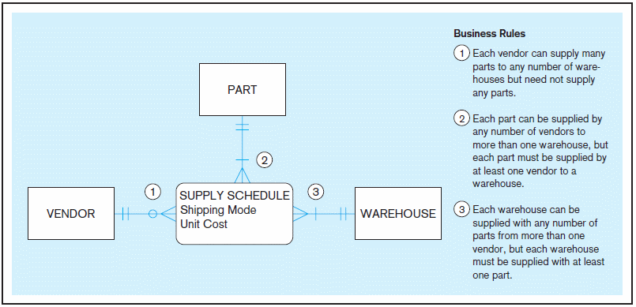
Figure 2-18 Cardinality constraints in a ternary relationship
Chapter 2
© 2013 Pearson Education, Inc. Publishing as Prentice Hall
Notes:
36

Slide 62
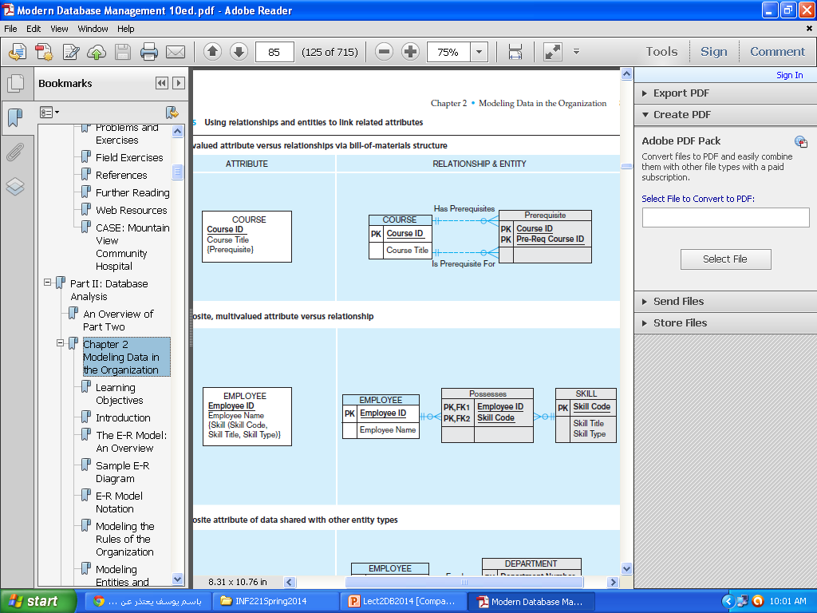
Multivalued attribute

Slide 63
Pine Valley Furniture Company
The company sells a number of different furniture products.
These products are grouped into several product lines.
The identifier for a product is Product ID, whereas the identifier for a product line is Product Line ID.
We identify the following additional attributes for product: Product Description, Product Finish, and Product Standard Price.
Another attribute for product line is Product Line Name.
A product line may group any number of products but must group at least one product.
Each product must belong to exactly one product line.

Slide 64
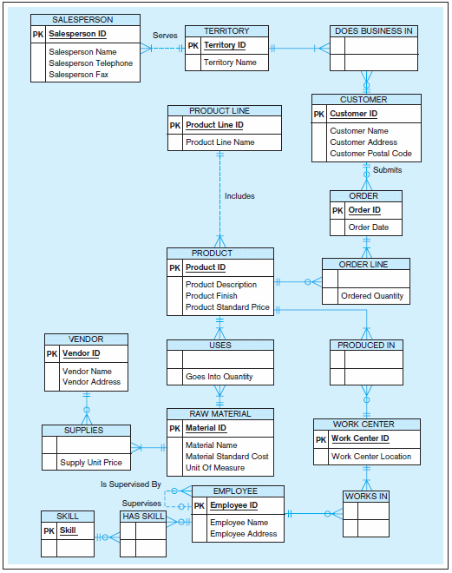

Slide 65
Pine Valley Furniture Company (2)
Customers submit orders for products. The identifier for an order is Order ID, and another attribute is Order Date.
A customer may submit any number of orders, but need not submit any orders.
Each order is submitted by exactly one customer.
The identifier for a customer is Customer ID.
Other attributes include Customer Name, Customer Address, and Customer Postal Code.

Slide 67
Pine Valley Furniture Company (3)
A given customer order must request at least one product and only one product per order line item.
Any product sold by Pine Valley Furniture may not appear on
any order line item or may appear on one or more order line items.
An attribute associated with each order line item is Ordered Quantity.

Slide 68
Pine Valley Furniture has established sales territories for its customers.
Each customer may do business in any number of these sales territories or may not do business in any territory.
A sales territory has one to many customers.
The identifier for a sales territory is Territory ID and an attribute of a Territory Name.
Pine Valley Furniture Company has several salespersons. The identifier for a salesperson is Salesperson ID.
Other attributes include Salesperson Name, Salesperson Telephone, and Salesperson Fax.
A salesperson serves exactly one sales territory.
Each sales territory is served by one or more salespersons.

Slide 69
ER Diagramming Tools
Free software ER diagramming tools that can interpret and generate ER models and SQL and do database analysis are MySQL Workbench (formerly DBDesigner),
Open ModelSphere (open-source). (www.modelsphere.org)
A freeware ER tool that can generate database and application layer code (webservices) is the RISE Editor.
SQL Power Architect while proprietary also has a free community edition.

Slide 70
How do we start an ERD?
Define Entities: these are usually nouns used in descriptions of the system, in the discussion of business rules, or in documentation;
2. Define Relationships: these are usually verbs used in descriptions of the system or in discussion of the business rules
3. Add attributes to the relations; these are determined by the queries,and may also suggest new entities, e.g. grade; or they may suggest the need for keys or identifiers.

Slide 71
4. Add cardinality to the relations
Many-to-Many must be resolved to two one-to-manys with an additional entity
Usually automatically happens
Sometimes involves introduction of a link entity (which will be all foreign key) Examples: Patient-Drug

Slide 72
Design Techniques
Avoid redundancy.
Limit the use of weak entity sets.
Don’t use an entity set when an attribute will do.

Slide 73


